Slide 1
RAG and Agentic AI
Gordon Gao
Carey Business School Professor

Slide 2
Retrieval-Augmented Generation

Slide 3
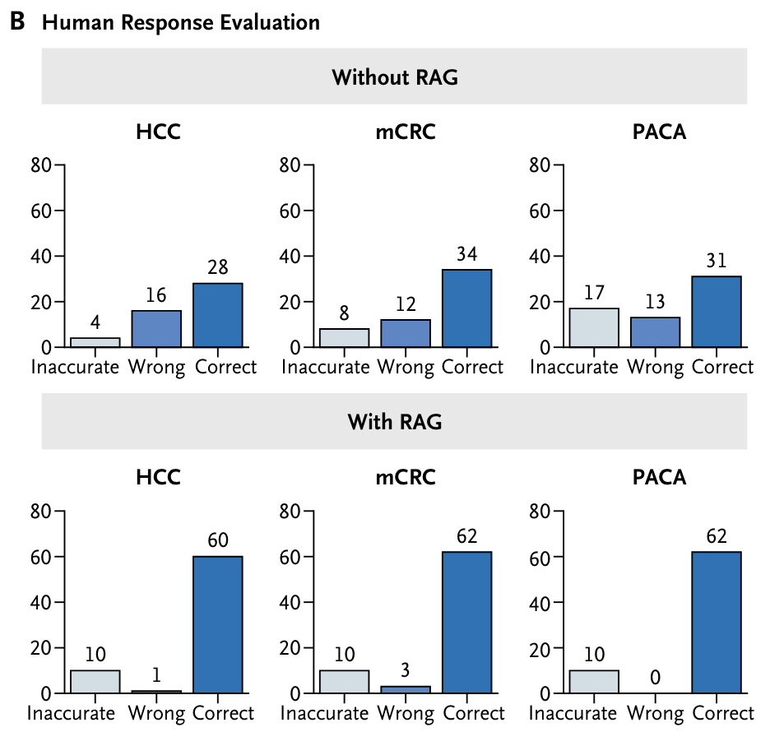
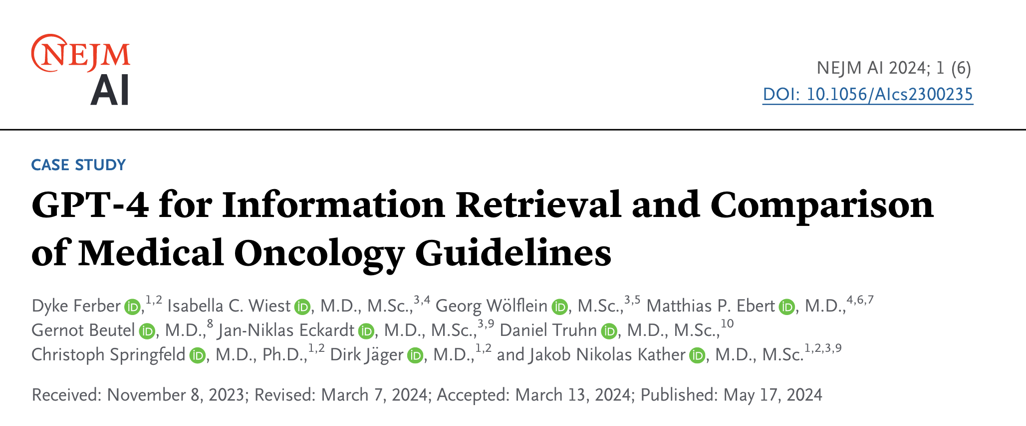
RAG improves GPT

Slide 4

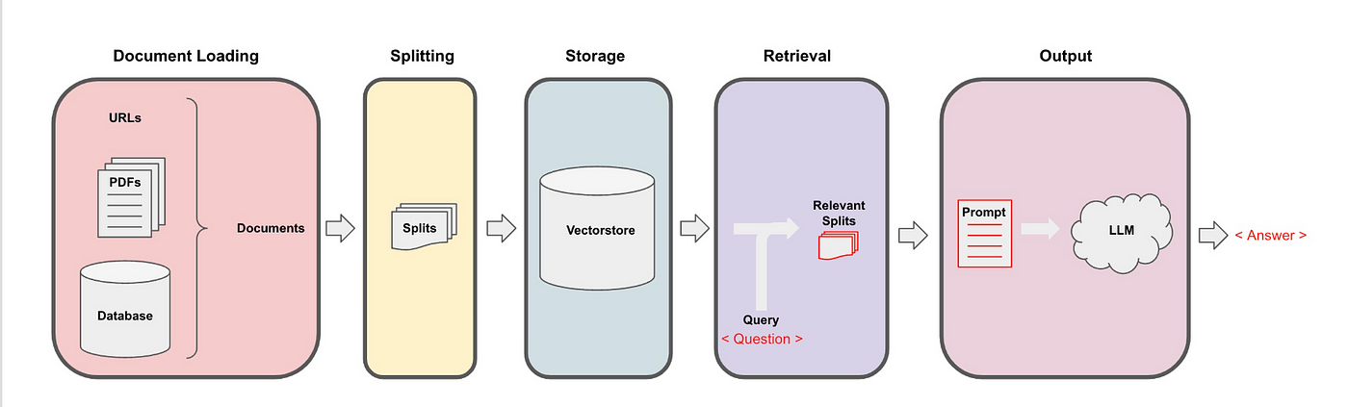

RAG:
Retrieval-Augmented
Generation
Send query
User

Slide 5
Prompt
Embedding
Collection of docs.
Make Embeddings of Chunks
VectorStore
Chunks
Similarity Search
Feed Source to LLM

Slide 6
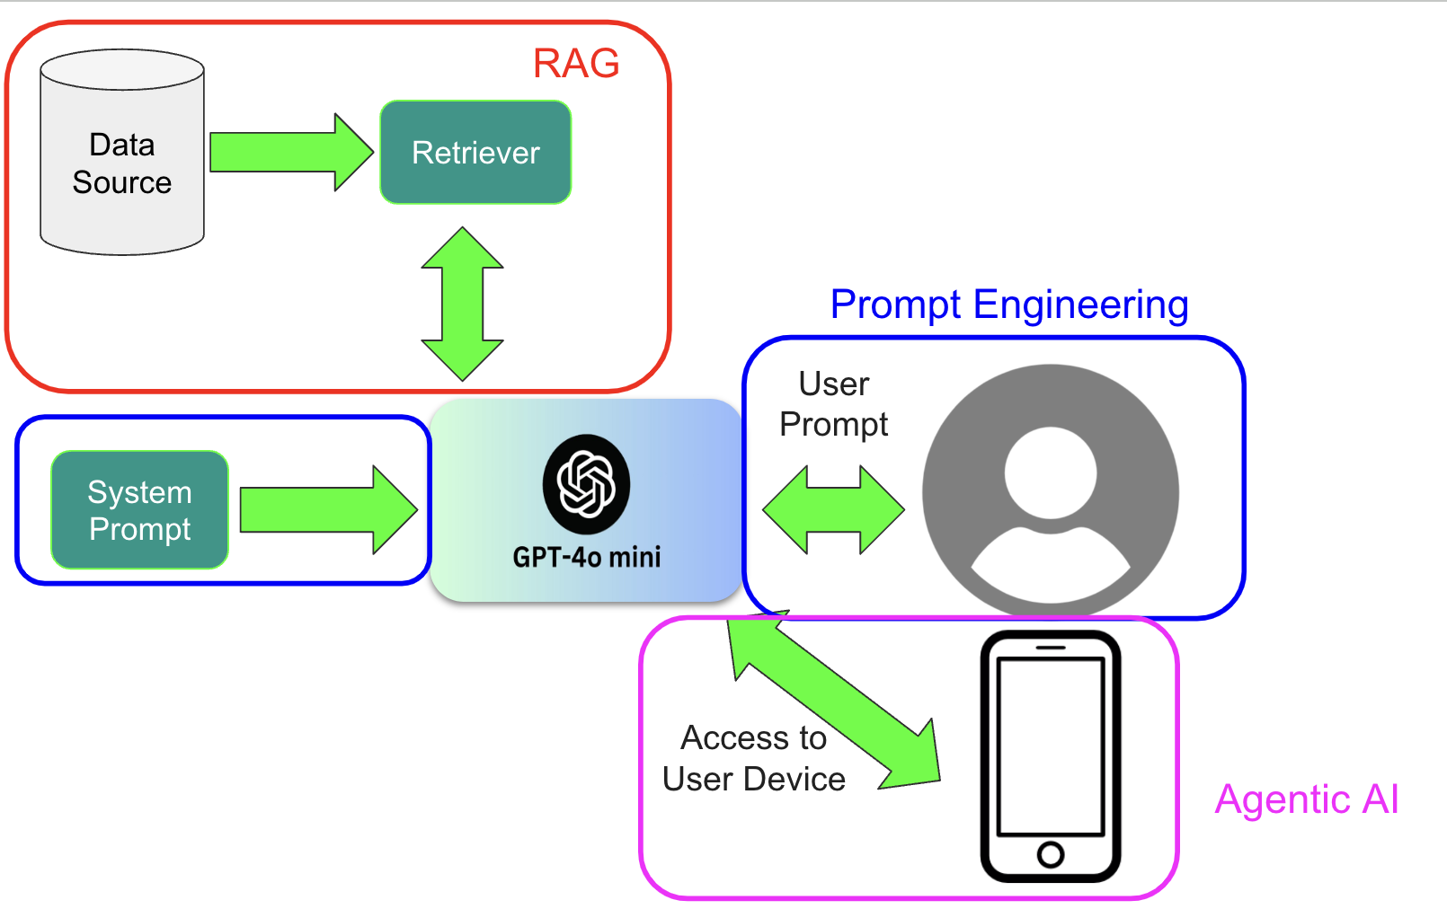
Schematic
Credit: https://medium.com/@ram.m.kripa_31353/ai-buzzwords-32ad7ad98af
Notes:
Credit:https://medium.com/@ram.m.kripa_31353/ai-buzzwords-32ad7ad98af

Slide 7


What Problems does RAG solve
Cost-effective implementation
Avoids expensive model retraining
Makes AI more accessible
Cost-effective approach to introducing new data to the LLM
Current Information
Allows developers to provide the latest research, statistics, or news to the generative models by connecting to live social media fees, news or other information sources
Maintains data relevancy
More developer control
With RAG, developers can test and improve their chat applications more efficiently
Better security
Enhanced user trust
Provides source attribution
Enables verification
https://aws.amazon.com/what-is/retrieval-augmented-generation/
Notes:
https://qatalog.com/blog/post/rag-use-cases/#what-problem-does-rag-solve

Slide 8
Build RAG to Query Resumes files
Colab: Colab RAG for Resume
Use Case:
Before an Interview
Analyze resume comprehensively
Extract nuanced professional details
Identify potential discussion points
Question Generation
Create targeted, personalized interview questions
Highlight specific career achievements
Explore gaps or unique experiences in candidate's background
Notes:
https://drive.google.com/drive/folders/1BT7iNrmPWYiQIgEJfdtqmwxCOnNnkCvW

Slide 9
Agentic AI

Slide 10
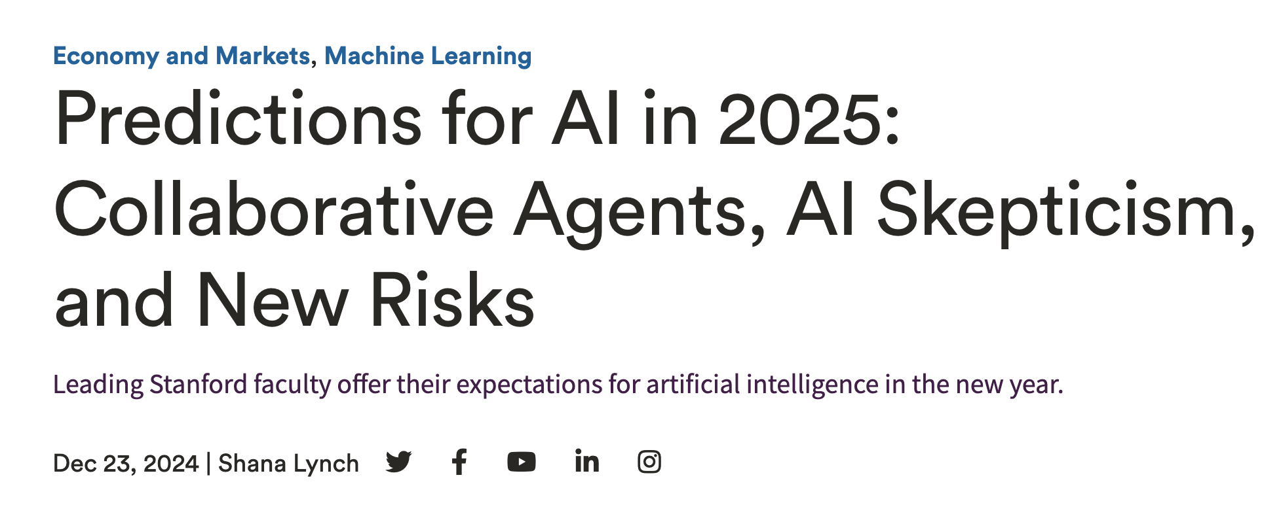
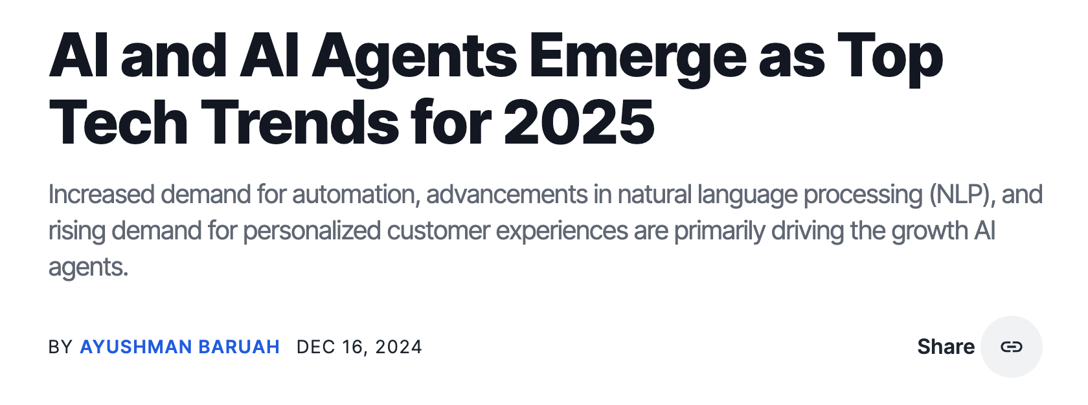

2025 will be the year of AI Agents
https://hai.stanford.edu/news/predictions-ai-2025-collaborative-agents-ai-skepticism-and-new-risks
Notes:
Sandford-- https://hai.stanford.edu/news/predictions-ai-2025-collaborative-agents-ai-skepticism-and-new-risks
Leading Stanford faculty offer their expectations for artificial intelligence in the new year.
We’re really going to see agents of AI – we saw it a bit in research, but now we’re seeing it a lot in research and industry. Essentially, how do you put these agents together to actually do things for you? And we’re now seeing interfaces. For example, there’s some API with Anthropic’s Claude where it can actually operate your computer to do things like put a meeting on your calendar or help you buy a plane ticket. Obviously, it has some risks – if they’re actually able to use your computer, they can do damage, they can make mistakes. So there are concerns with how this is done. But while the first versions of these kinds of tools weren’t successful, we’re now seeing more potential.
AI Agents Work Together
In 2025, we will see a significant shift from relying on individual AI models to using systems where multiple AI agents of diverse expertise work together. As an example, we recently introduced the Virtual Lab, where a professor AI agent leads a team of AI scientist agents (e.g., AI chemist, AI biologist) to tackle challenging, open-ended research, with a human researcher providing high-level feedback. By leveraging the multidisciplinary expertise of different agents, the Virtual Lab successfully designed new nanobodies that we validated as effective binders to recent SARS-CoV-2 variants. Looking ahead, I predict that many high-impact applications will use such teams of AI agents, which are more reliable and effective than a single model. I’m particularly excited about the potential of hybrid collaborative teams where a human leads a group of diverse AI agents.
Yahoo-- https://finance.yahoo.com/news/from-microsoft-to-nvidia-the-ai-agents-are-coming-in-2025-141314094.html
Notes: If 2024 was the year of artificial intelligence chatbots becoming more useful, 2025 will be the year AI agents begin to take over. You can think of agents as super-powered AI bots that can take actions on your behalf, such as pulling data from incoming emails and importing it into different apps.
We’re really going to see agents of AI – we saw it a bit in research, but now we’re seeing it a lot in research and industry.

Slide 11
AI agents are AI workers, digital employees
https://www.youtube.com/watch?v=E_RErqD1kv8
https://www.youtube.com/watch?v=x8O6ChAWBxs&t=3s
Notes:
https://finance.yahoo.com/news/from-microsoft-to-nvidia-the-ai-agents-are-coming-in-2025-141314094.html
You’ll find AI agents at the office and on your phone
The AI chatbot/AI copilot/AI agent discussion can be a bit confusing. After all, generative AI chatbots still feel like a new technology, and now we’re already being shuffled on to the next big thing. But those three capabilities are all part of the same overall system.
Ray Smith, Microsoft’s vice president of AI agents, says you can think of an AI copilot as your main interface for interacting with your chatbot or assistant. Kind of like a home screen for your different AI needs.
When you ask your chatbot or assistant to complete various tasks for you, it will reach out to the AI agents with the appropriate capabilities.

Slide 12

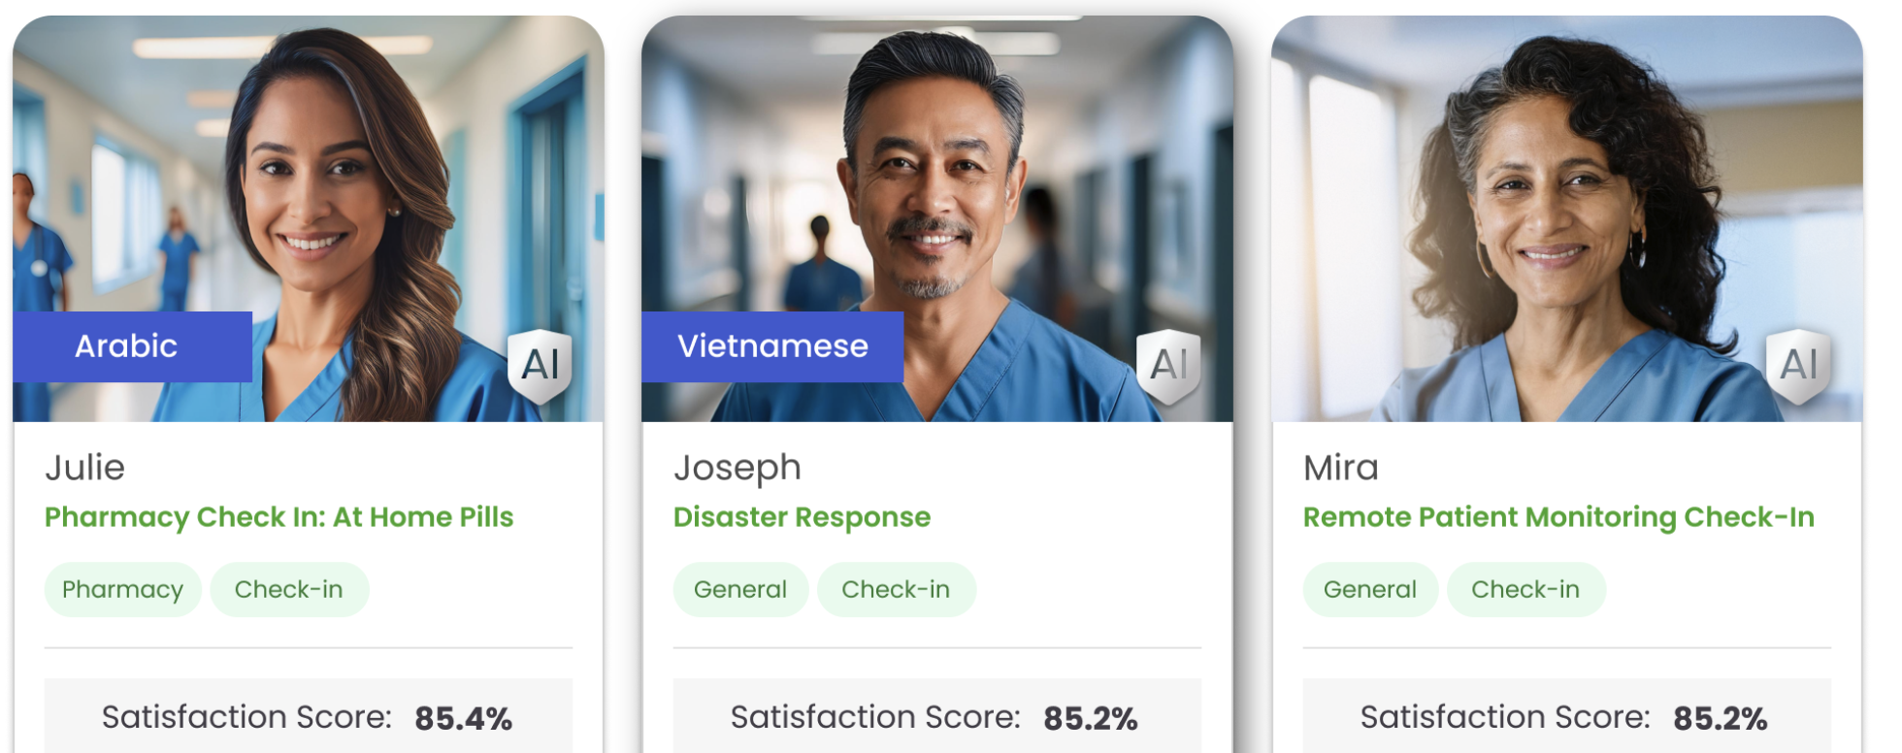


Hippocratic AI and Nvidia: Digital Human
Hippocratic AI's digital humans are designed to assist with various tasks, including:
Guiding patients on follow-up care and prescribed drug regimens
Chronic care management
Wellness coaching
Health risk assessments
Answering hospital policy questions
Health system and payor partners tested the product internally. They expanded access to 4,500+ nurses and 275+ doctors for testing.
Demo

Slide 13
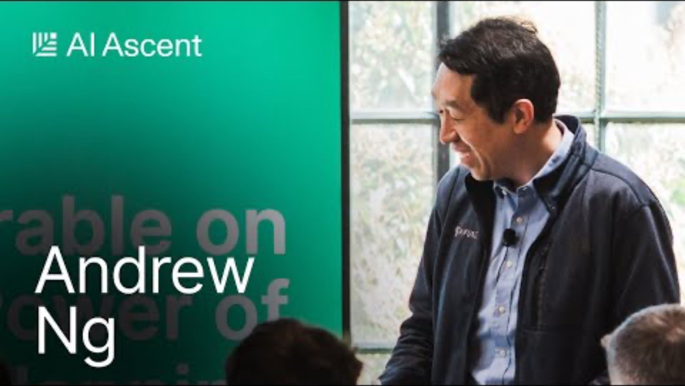

Slide 14
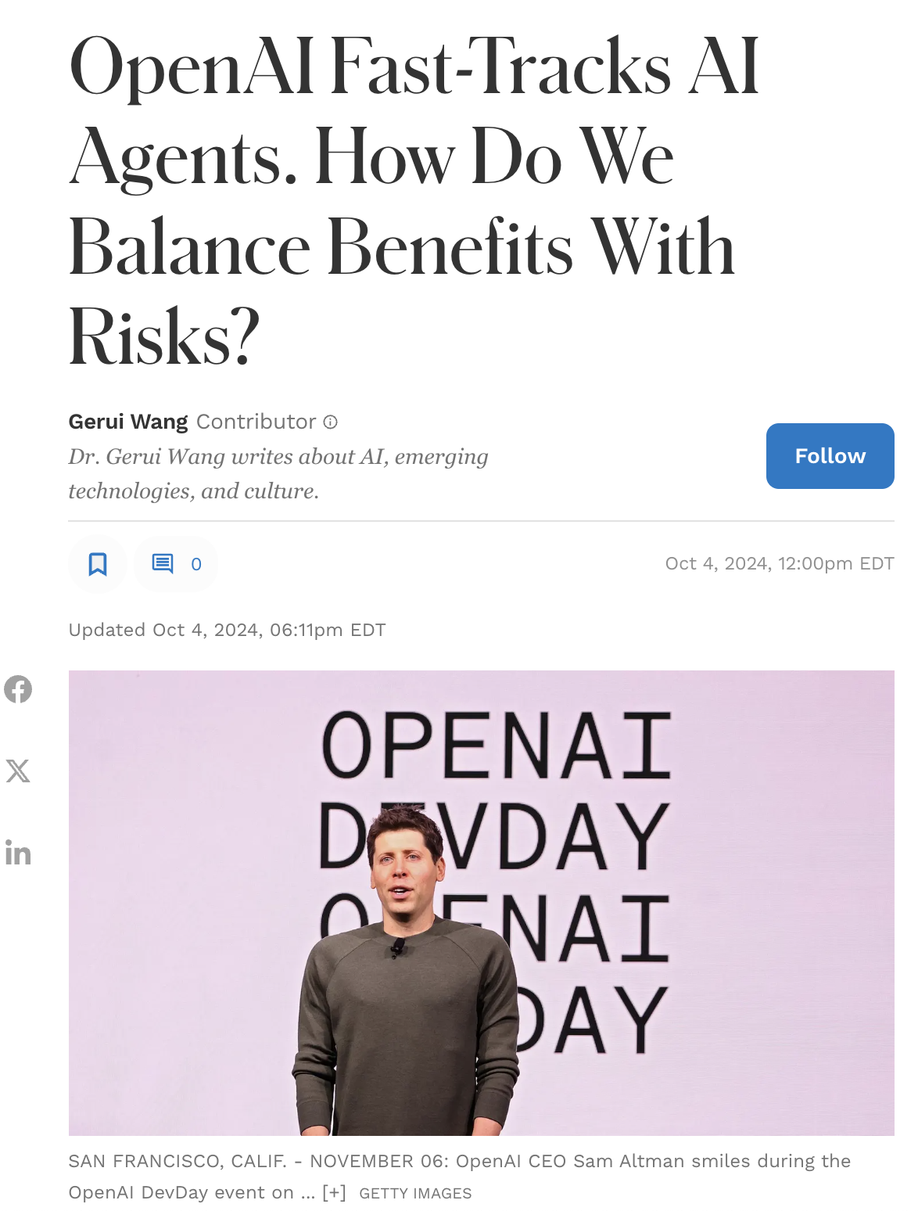
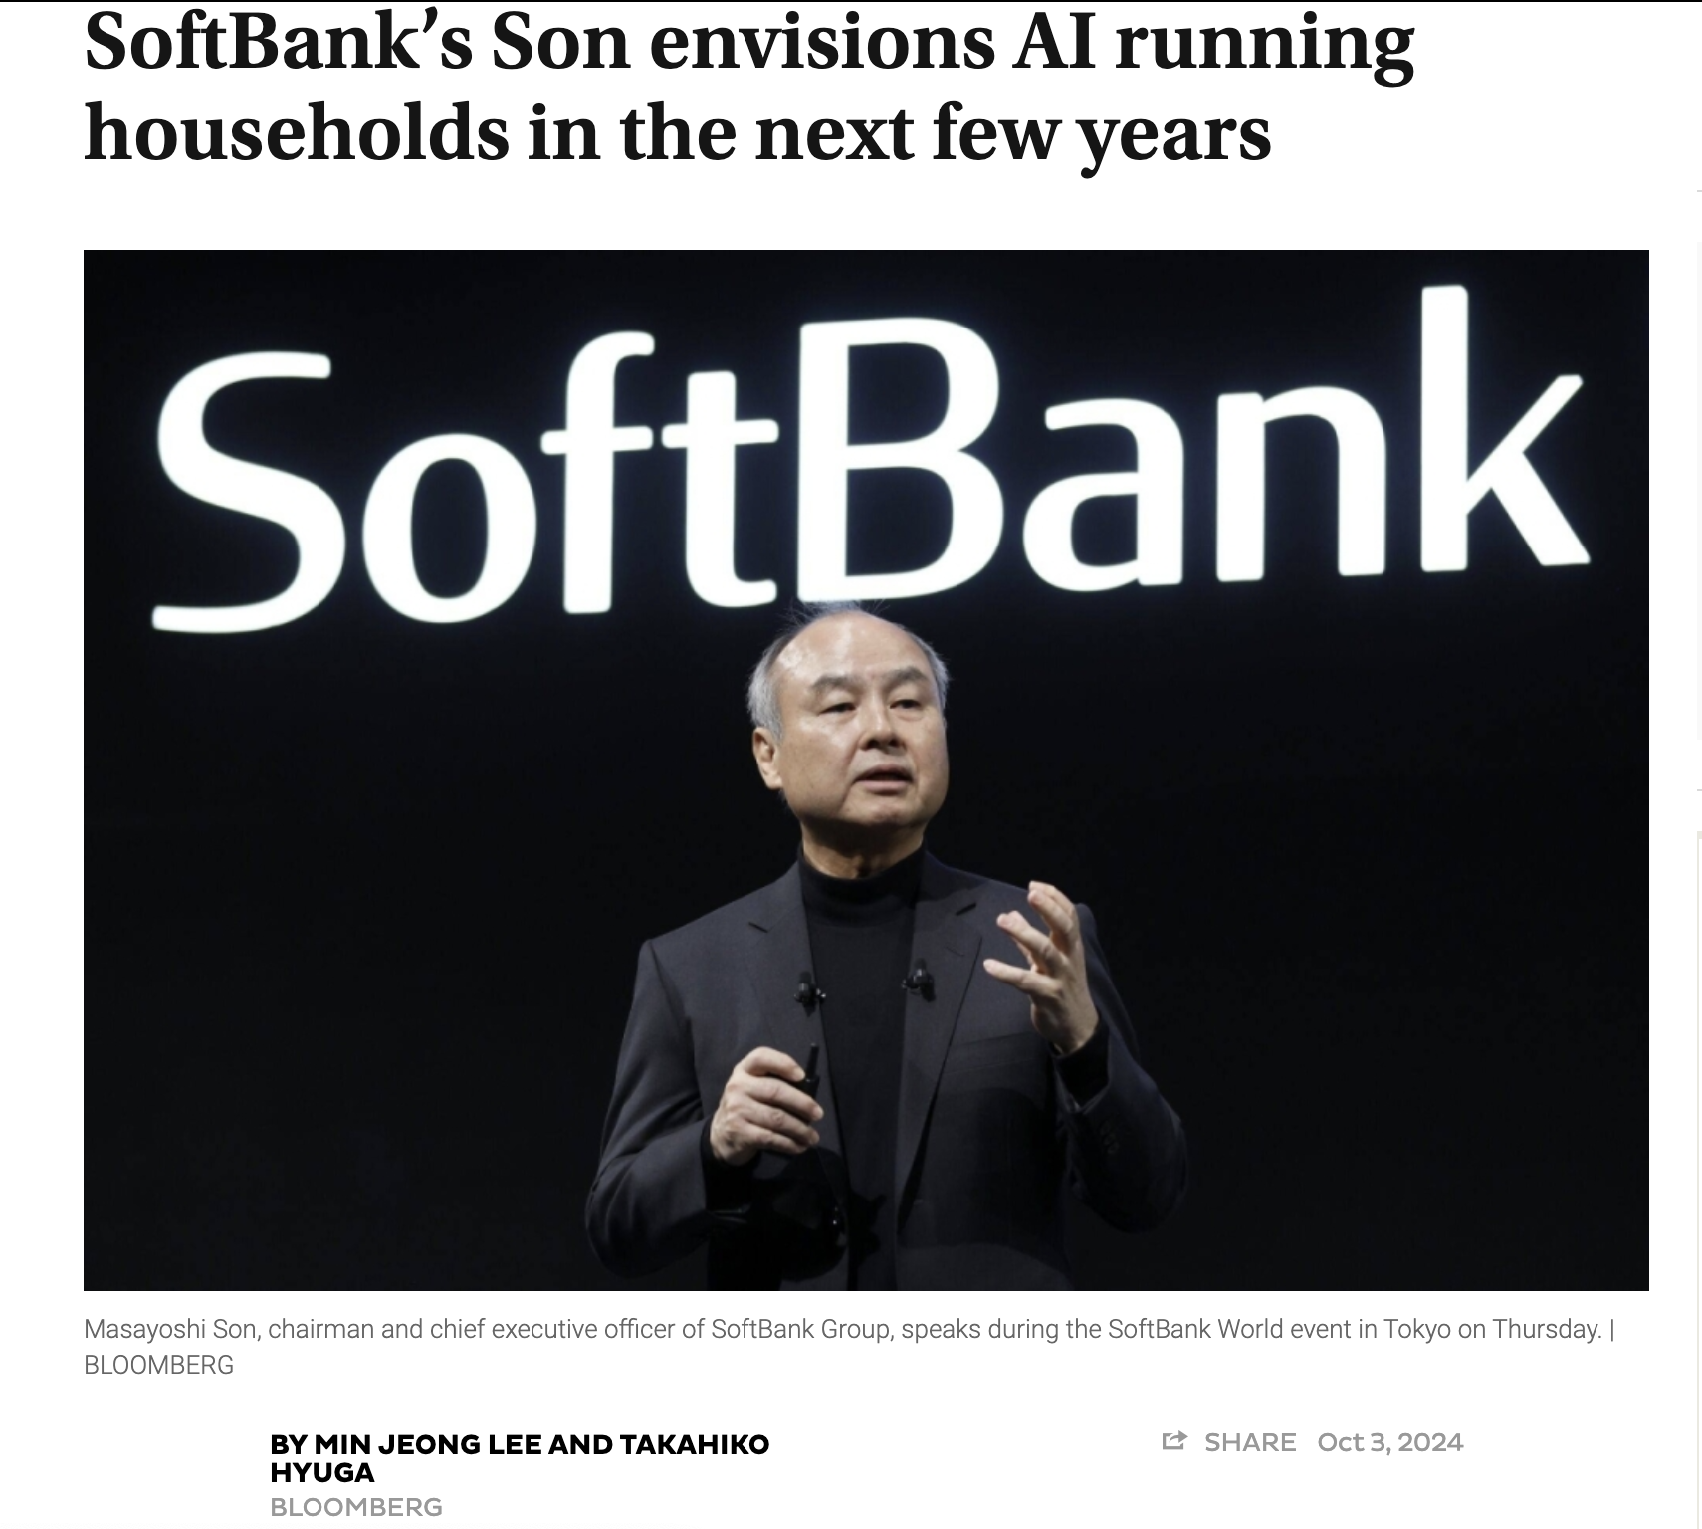
OpenAI raised $6.6 billion in funds at $157 billion value, making it the largest venture capital deal of all time. The funds will enable access to more computing resources, which are essential to enhance the development of AI agents.
SoftBank, which also agreed to invest $500 million in OpenAI in the latest funding round, outlined that AI agents will soon manage entire households.
Notes:
https://www.japantimes.co.jp/business/2024/10/03/companies/softbank-son-ai-push/

Slide 15
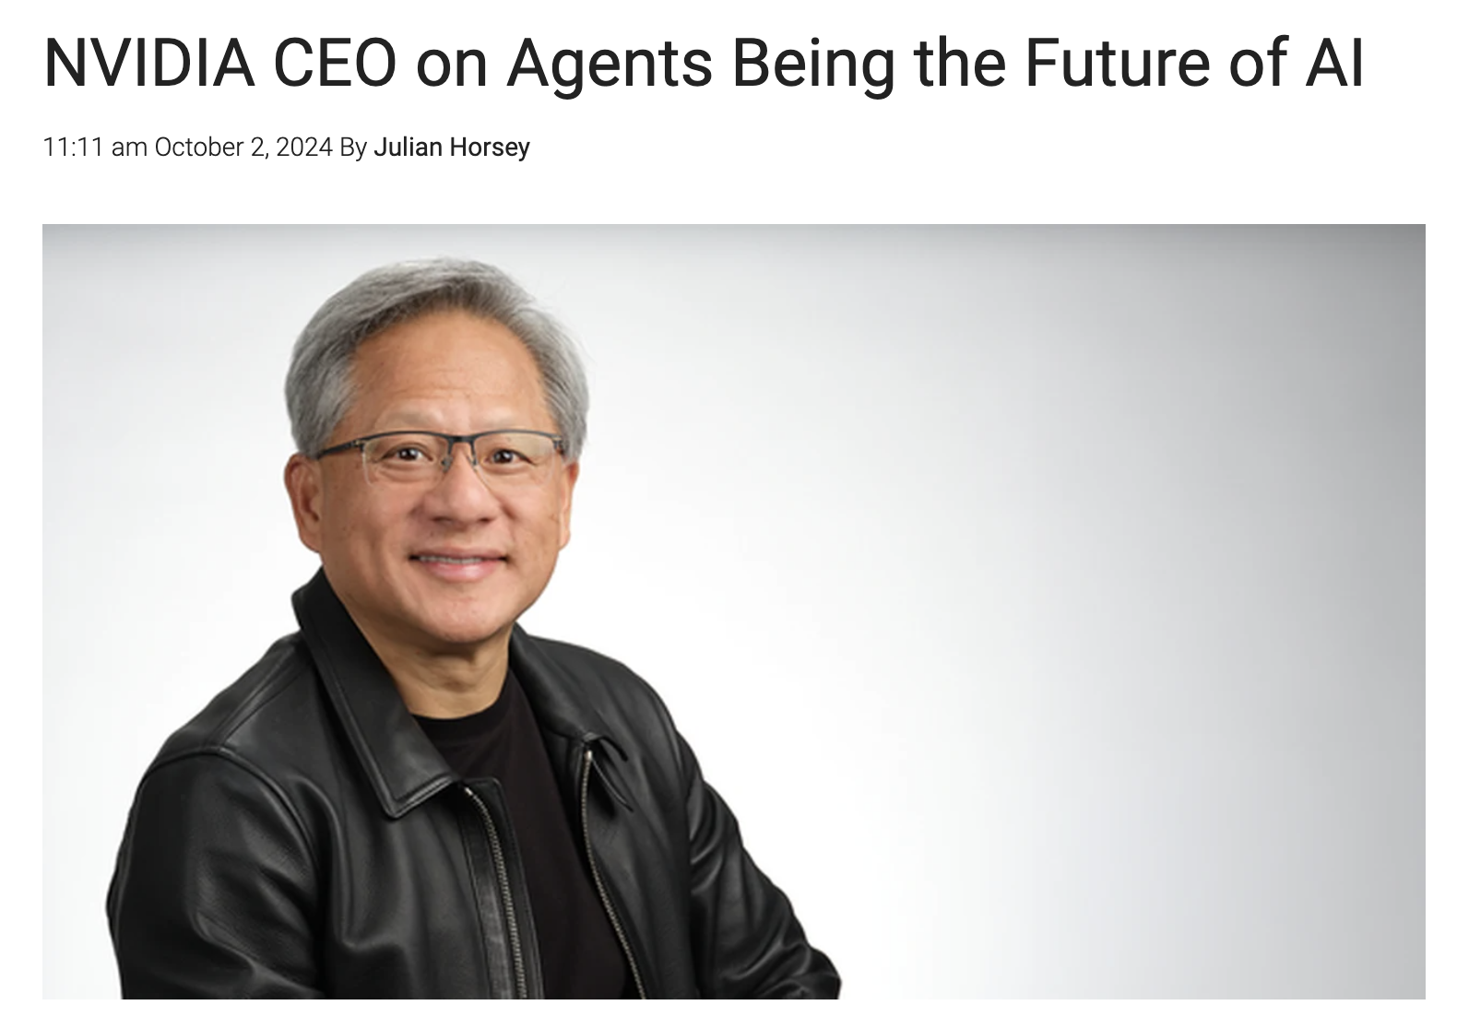
AI agents will revolutionize industries by automating tasks and boosting productivity.
Shift from tools-based to skills-based industry, enhancing efficiency and innovation.
https://www.geeky-gadgets.com/nvidia-ceo-on-agents-being-the-future-of-ai/
Notes:
https://www.geeky-gadgets.com/nvidia-ceo-on-agents-being-the-future-of-ai/

Slide 16
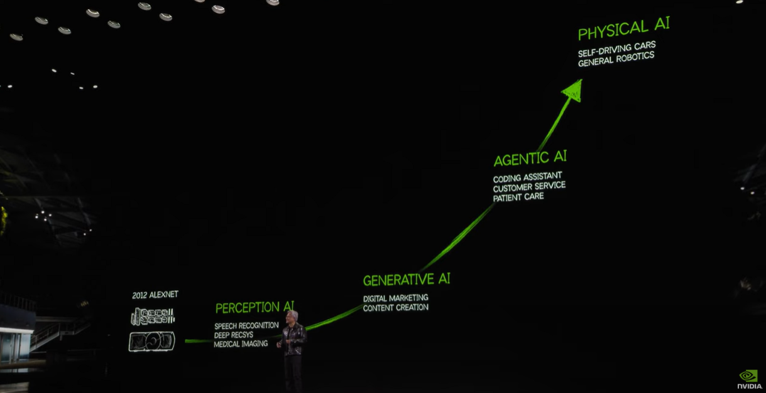
The Future of AI - CES 2025

Slide 17
Discussion: Chatbots vs. Agents
Chatbots
Agents

Slide 18
Chatbot vs Agent
Chatbot
Language-based/multimodality
Chat
Agent
Language-based/multimodality
Chat
Know the context
Can be delegated to make decisions
Coordinate with other agents
Can use tools and take action
Better and longer memory
Can get feedback and learn

Slide 19
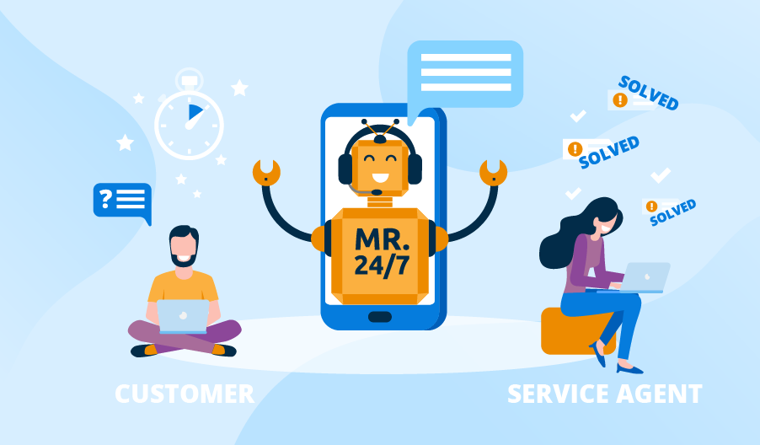
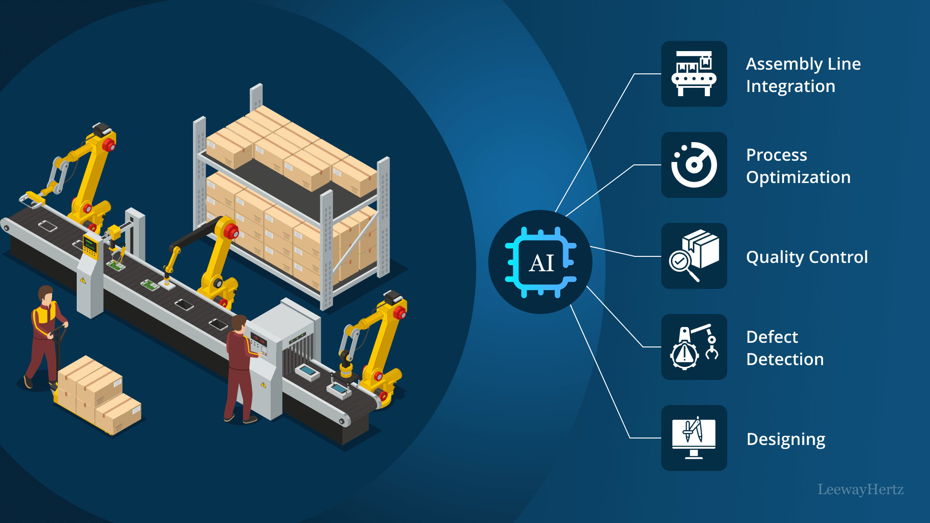

What are AI Agents?
All software autonomously completes different tasks as determined by the software developer.
AI agents can be deployed across various business functions:
Customer Service: Chatbots that handle
customer inquiries 24/7
Operations: Agents that optimize
inventory management and logistics
Finance: Algorithms that detect fraud and manage risk
https://aws.amazon.com/what-is/ai-agents/
Notes:
New https://www.scnsoft.com/blog/customer-service-chatbot https://www.leewayhertz.com/ai-use-cases-in-manufacturing/

Slide 20
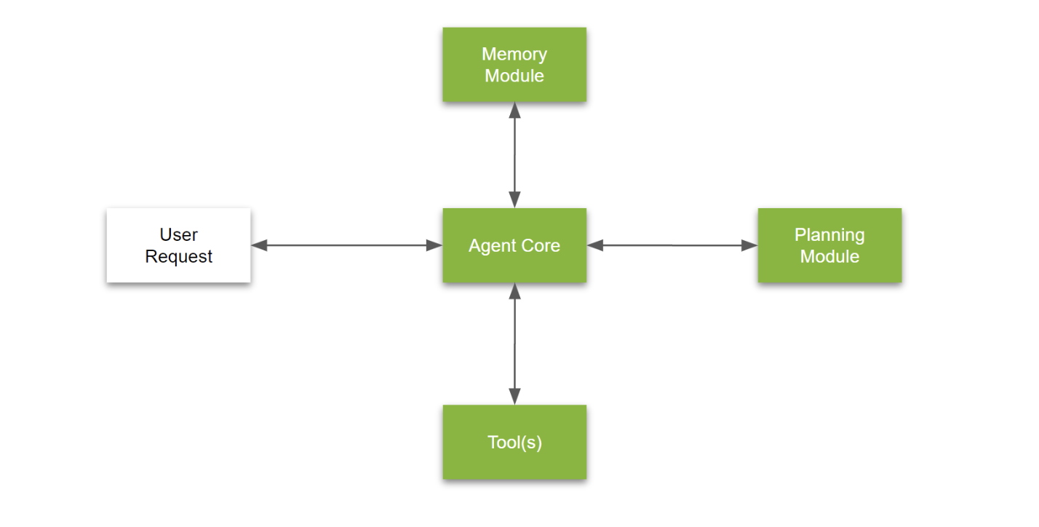
LLM-Powered Agents
Definition: A system that uses an LLM to:
Reason through problems
Create solution plans
Execute plans using tools
Key Components
Complex reasoning capabilities
Memory
Task execution tools
In Essence
LLM-powered agents are a system with complex reasoning capabilities, memory, and the means to execute tasks.
Note: No widely accepted definition; this is a working description from Nvidia
https://developer.nvidia.com/blog/introduction-to-llm-agents/
Notes:
https://developer.nvidia.com/blog/introduction-to-llm-agents/ While there isn’t a widely accepted definition for LLM-powered agents, they can be described as a system that can use an LLM to reason through a problem, create a plan to solve the problem, and execute the plan with the help of a set of tools.
In short, agents are a system with complex reasoning capabilities, memory, and the means to execute tasks.

Slide 21
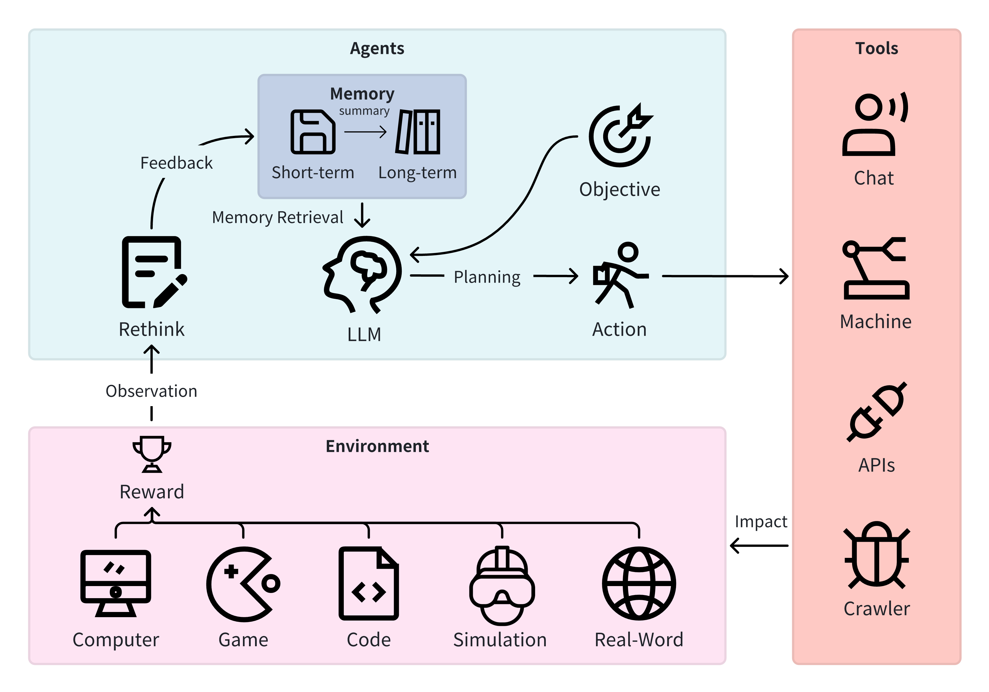
LLM-Based Single-Agent Systems
Key Capabilities
Comprehensive language understanding and generation
Adapts to various tasks (multi-task generalization)
Performs diverse functions without additional agents
Task Examples
Code generation
Game exploration
Data management
https://arxiv.org/html/2401.03428v1

Slide 22
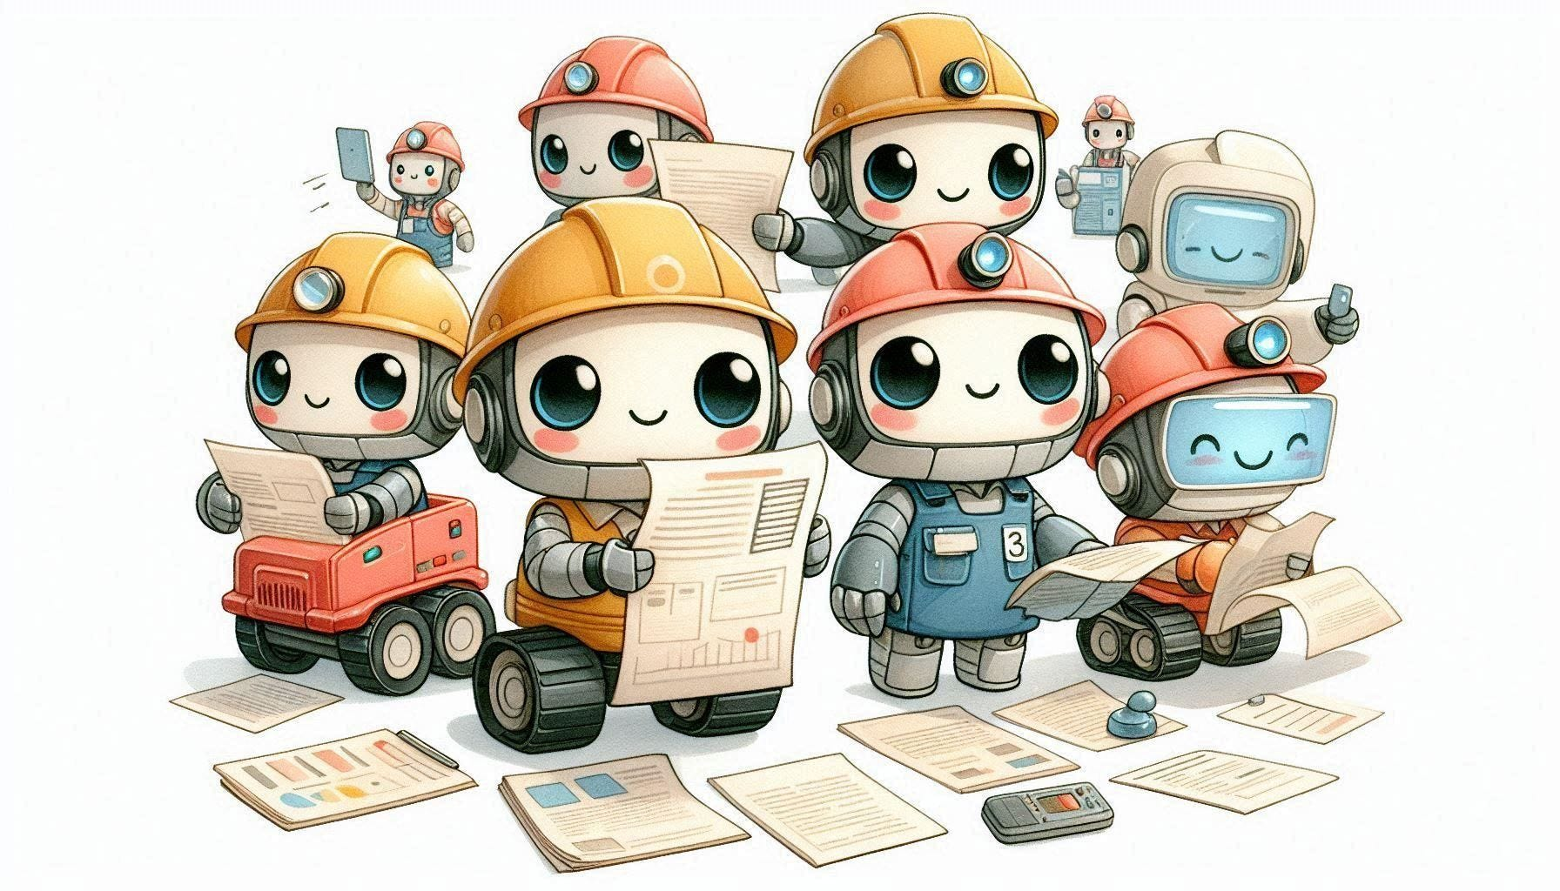
LLM-Based Multi-Agent Systems
Definition
Unlike a single-agent system, a multi-agent system (MAS) is a computerized system composed of multiple interacting intelligent agents
Inspired by Minsky's Society of Mind (SOM) and natural language-based SOM (NLSOM)
Key Characteristics
Intricate coordination among agents
Agents with specific domain expertise
Advantageous for multi-domain tasks

Slide 23
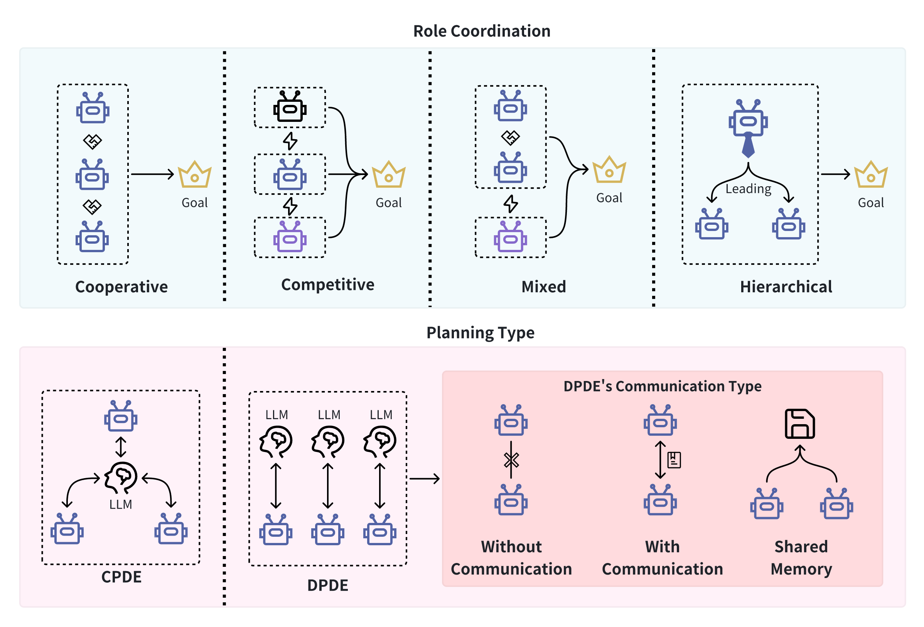
Categorization for LLM-Based MAS
Multi-Role Coordination:
Cooperative
Competitive
Mixed
Hierarchical
Planning Type:
Centralized Planning Decentralized Execution (CPDE)
Decentralized Planning Decentralized Execution (DPDE)
https://arxiv.org/html/2401.03428v1
Notes:
Benefiting from recent progress in large language models (LLMs), LLM-based agents that use universal natural language as an interface exhibit robust generalization capabilities across various applications – from serving as autonomous general-purpose task assistants to applications in coding, social, and economic domains, LLM-based agents offer extensive exploration opportunities.
This paper surveys current research to provide an in-depth overview of LLM-based intelligent agents within single-agent and multi-agent systems. It covers their definitions, research frameworks, and foundational components such as their composition, cognitive and planning methods, tool utilization, and responses to environmental feedback. We also delve into the mechanisms of deploying LLM-based agents in multi-agent systems, including multi-role collaboration, message passing, and strategies to alleviate communication issues between agents. The discussions also shed light on popular datasets and application scenarios. We conclude by envisioning prospects for LLM-based agents, considering the evolving landscape of AI and natural language processing.
Unlike a single-agent system, a multi-agent system (MAS) is a computerized system composed of multiple interacting intelligent agents [22]. Inspired by Minsky’s Society of Mind (SOM) [23] and natural language-based SOM (NLSOM) [24], Multi-Agent Systems (MAS) design demands a heightened level of intricate coordination among various agents, particularly in their interactions and information sharing. Each agent typically possesses specific domain expertise, making Multi-Agent systems particularly advantageous for tasks spanning multiple domains.
Decker [25] outlines a four-dimensional framework for an MAS. The dimensions encompass: 1) Granularity of Agents, ranging from coarse to acceptable configurations; 2) Heterogeneity in Agent Knowledge, comparing agents with redundant knowledge to those with specialized expertise; 3) Mechanisms for the Distribution of Control, which can be categorized as benevolent or competitive, team-oriented or hierarchical, and may involve static or shifting role assignments; 4) Varieties of Communication Protocols, differentiating between the blackboard and message-based systems and specifying the gradation from low-level to high-level contents.

Slide 24
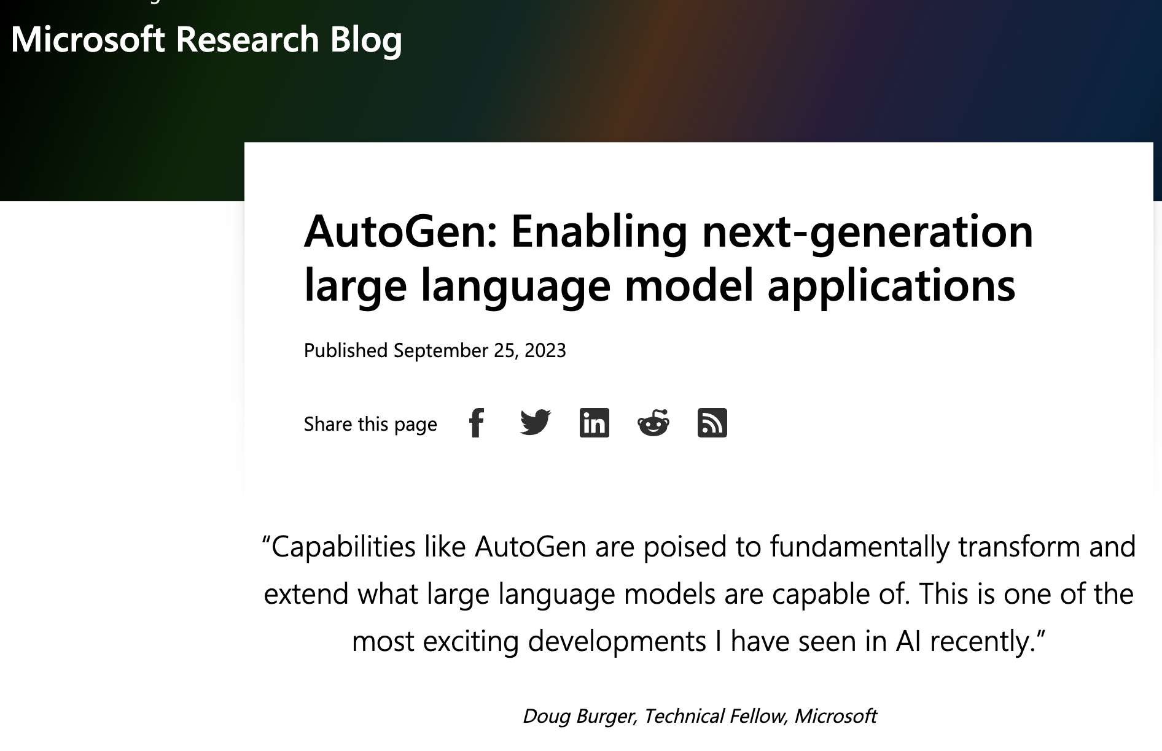
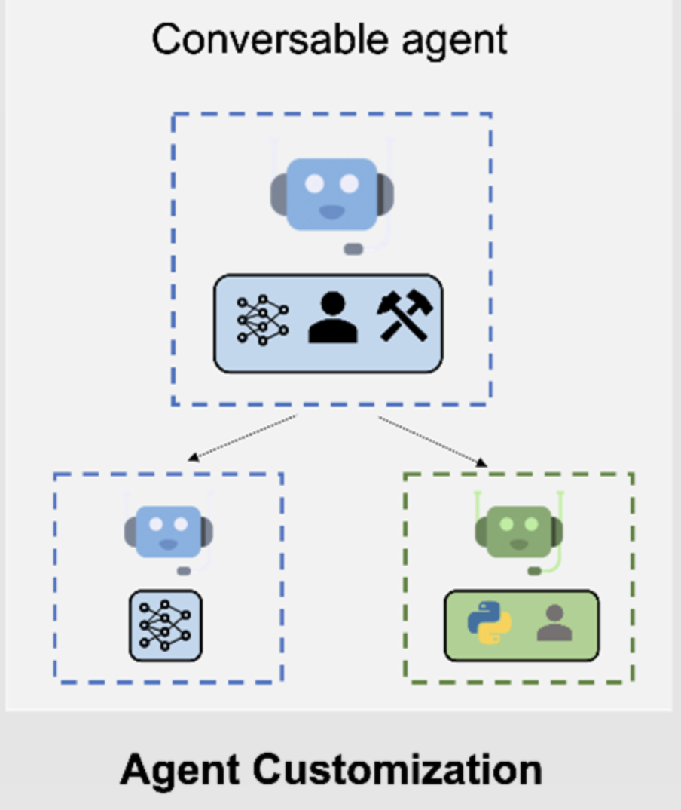
Demo- AutoGen

Slide 25
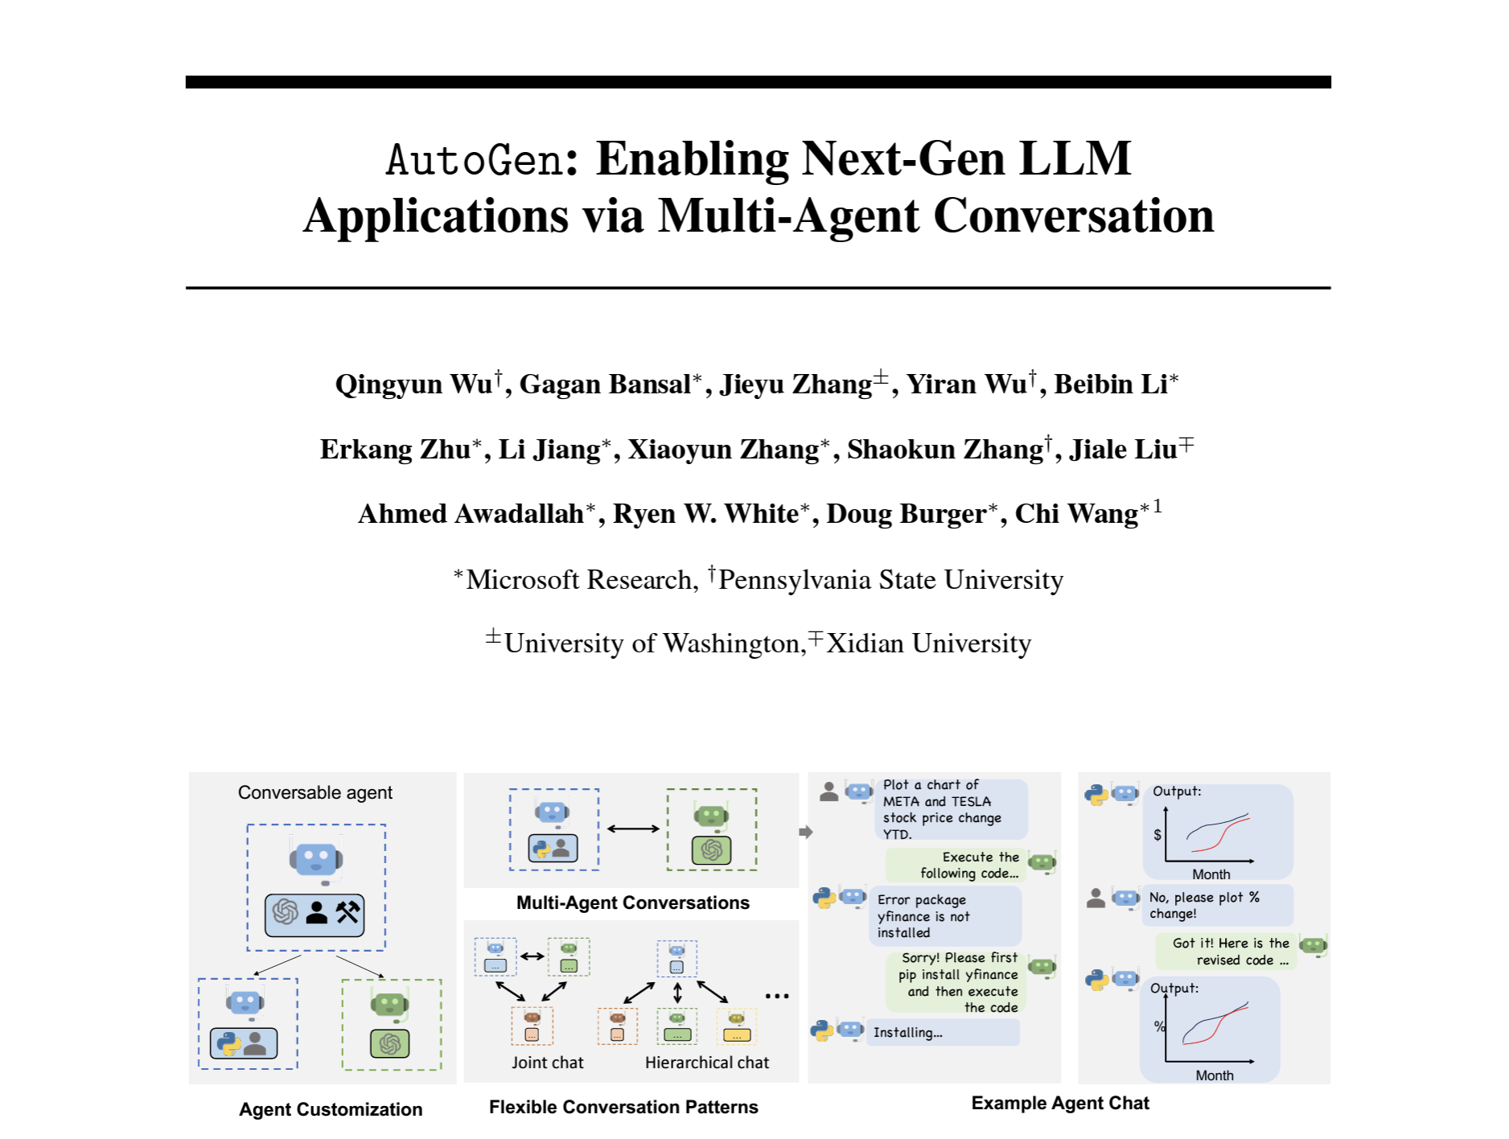
Multi-Agent System and AutoGen
Chatoptimized LLMs (e.g., GPT-4) show the ability to incorporate feedback, LLM agents can cooperate through conversations with each other or human
LLMs have demonstrated ability to solve complex tasks when the tasks are broken into simpler subtasks. Multi-agent conversations can enable this partitioning and integration in an intuitive manner.
A fundamental insight of AutoGen is to simplify and unify complex LLM application workflows as multi-agent conversations.
https://arxiv.org/abs/2308.08155

Slide 26


Admin
Acts as a human administrator. Interacts with the Planner to discuss and approve plans.
revises them based on feedback from the Admin and Critic.
Plans may involve tasks for the Engineer and the Scientist.
Chat manager
Planner
Critic
Directs messages to the right agents
Keeps track of ongoing conversations
Manages which agents are active
Handles multiple conversations at once Deals with any errors in communication
Follows approved plans to write Python or shell code to solve tasks
Double-checks plans, claims, and code from other agents.
Provides feedback and ensures the plan includes verifiable information
Engineer
Scientist
Follows approved plans
Executes code written by the Engineer
Executor

Slide 27
Demo:
Agents_groupchat_stock_compare.ipynb

Slide 28




Popular AI Agent frameworks
Best for: Multi-agent conversations and interactions
Unique feature: Advanced orchestration of multiple AI agents working together
Best for: Production-ready agent systems
Unique feature: Structured task delegation among specialized agents
Best for: Data-centric AI applications
Unique feature: Superior data integration and retrieval for enhancing LLM responses
Best for: Versatile AI applications beyond just agents
Unique feature: Easy integration of various tools and services with LLMs

Slide 29
AI Applications

Slide 30



Final Thoughts – Work Creatively with AI
Current AI Use Pattern
The Mindshift Needed
Use AI like a search engine
Human – AI collaboration for innovation
Following fixed steps for answers:
ask -> receive -> filter -> select
Challenging conventional mindsets
Cultivating a culture where “the impossible” becomes a daily achievement
Limited to known possibilities
Notes:
Traditional Search Engine Process
Input query -> Match keywords -> Rank results -> Display links
This process is inherently linear and predictable
The steps don't change regardless of the query type

Slide 31

12 Exercises for Creative AI Collaboration
1. Set daily "exploratory prompting" practice
2. Frame "What if" and "How might we" questions
3. Embrace ambiguity and curiosity
4. Focus on exploration over solutions
5. Use chain prompts for iteration
6. Think metaphorically
7. Prompt for diverse perspectives
8. Experiment with role-play prompts
9. Ask for "impossibilities"
10. Consider AI's unique viewpoint (WWAID)
11. Schedule future-driven sessions
12. Keep a breakthrough prompt journal
https://hbr.org/2024/11/train-your-brain-to-work-creatively-with-gen-ai
Notes:
https://hbr.org/2024/11/train-your-brain-to-work-creatively-with-gen-ai

